Slide 1

Project Title – Airbnb Hotel Booking Analysis
Manish Pandey
INTERNSHIP_ 2001-4K-1010 APPLY_175601111668aa9a6cd8734

Slide 2

PROBLEM STATEMENT
Airbnb is a popular platform where property owners rent out their homes or apartments to travelers . One of the biggest challenges for hosts is deciding the right price for their listings, since prices vary depending on several factors such as the number of bedrooms, no of bathrooms , cleanliness ,accuracy of descriptions , and communication quality with guests .

Slide 3
Project Description
This project aims is to focuses on building a machine learning model to predict the price of Airbnb listings.
Pricing an Airbnb property correctly is crucial for both hosts and travelers : Hosts wants to maximize occupancy and earnings , while travelers want fair and competitive prices. Using Historical Airbnb data, the project develops a regression model that learns relationship between listing attributes (such as no of bedrooms, bathrooms ,and guest ratings) and the price charged.
The model can then be used to predict prices for new or hypothetical listings, helping property owners make informed pricing decisions.

Slide 4

WHO ARE THE END USERS?
Airbnb Host
To optimize pricing of their listings based on property features and guest reviews.
Travelers
To evaluate whether a listing is overpriced or reasonably priced.
Airbnb Platform Analysts
To improve automated pricing suggestions and increase platform trust.
Researchers / Students
To study the impact of property features and reviews on rental pricing.

Slide 5

Technology Used
Python – Core Programming Language.
Pandas & Numpy - Data cleaning & preprocessing.
Scikit-learn – Machine learning (model training, regression, evaluation).
Matplotlib / Seaborn – Data Visualization & Feature Importance.
Visual studio code – idle environment for running the project.

Slide 6
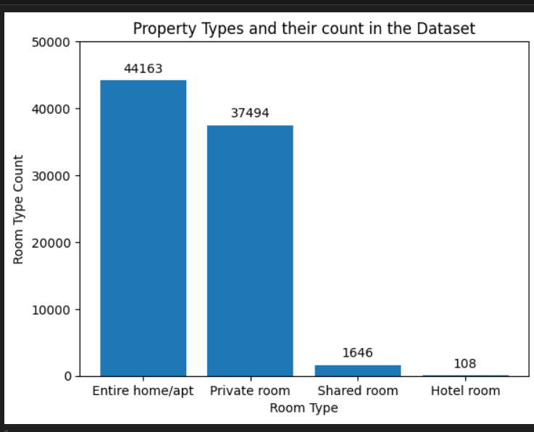
RESULT 1

Slide 7
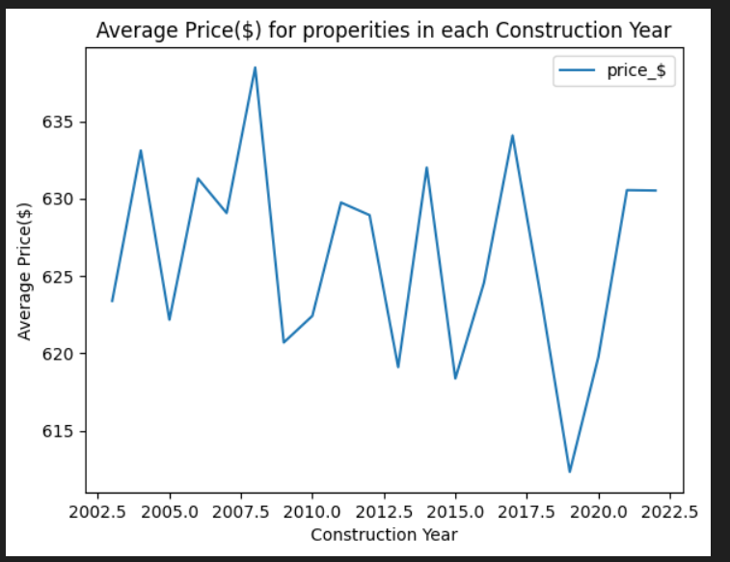
RESULT 2

Slide 8
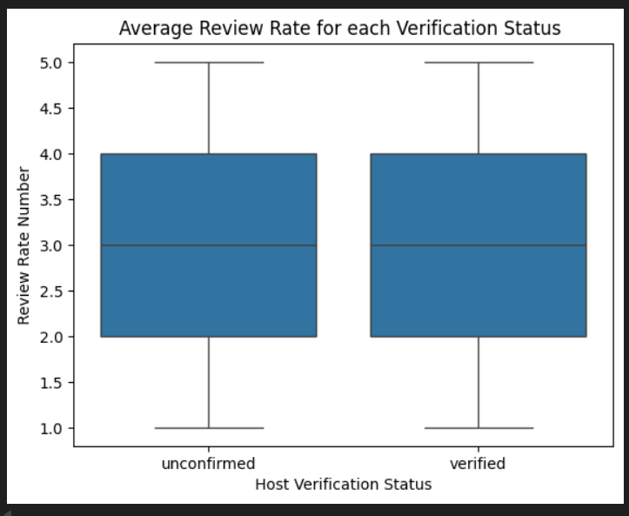
RESULT 3

Slide 9
GitHub Respository
https://github.com/Manishpandey18th/VOIS_AICTE_Oct2025_Manish

Slide 10
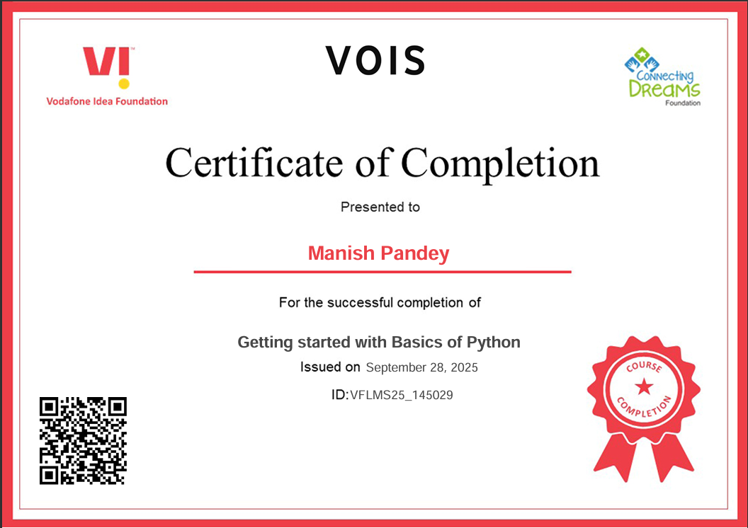
Getting started with Basics of Python Certificate

Slide 11
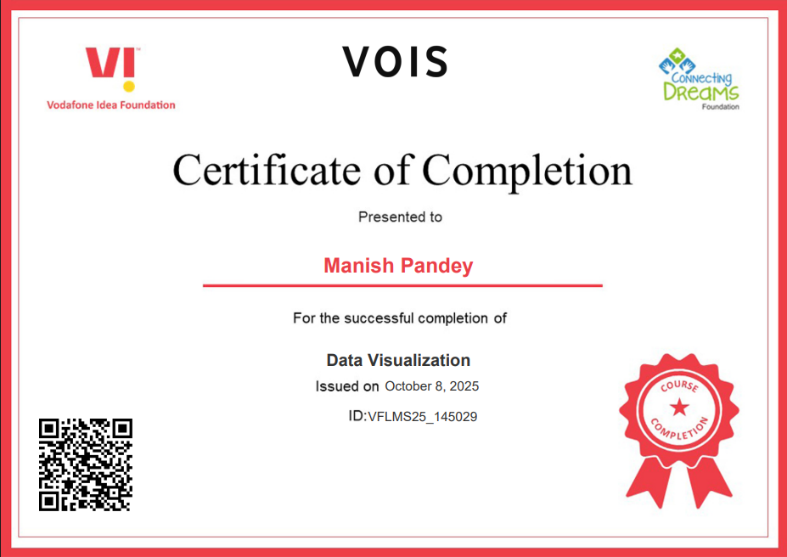
Data Visualization

Slide 12
Thank you
.
.

